Slide 1


Android Application Development
Unit – 5
Location Based Services, Hardware Sensor and Web Services
Prof. Hardik Chavda
FOCA,MU

Slide 2

Unit – 5
Location API fundamentals
Using Location Based Services
Finding Current Location and Listening for Changes in Location
Introduction to Geocoder
Working with Google Maps
Sensor API
Types of Sensor
Sensor class
SensorManager class
SensorEvent class
SensorEventListener Interface
Introduction to JSON Parsing
Introduction to Monetization of Android App
Signing and Publishing Android App

Slide 3
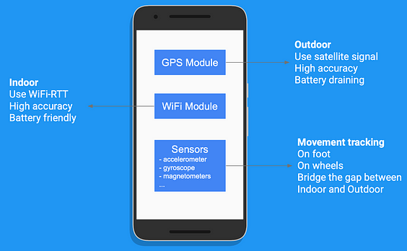
Location API fundamentals
GPS Module — The dedicated module for location, it uses satellite signals to determine the location so it can only be used outdoor. it is very accurate, but also consumes a lot of power.
WiFi Module — We can use WiFi-RTT (Round-trip-time) API, which is available in Android 9 and above, to measure the distance to nearby WiFi access points. Then we can use these distances to triangulate the device location with an accuracy of 1–2 meters. It does not consume too much battery as GPS Module does.
Sensors — Most of the Android phones nowadays are equipped with Sensors that track the device movement, and it also bridges the gap which we will discuss later.

Slide 4
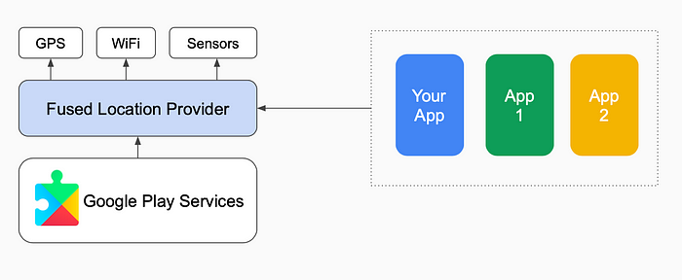
Using Location Based Services
Fused Location Provider API:
It intelligently combines different signals to compute the location information that your app needs. So that you do not need to worry about how location is calculated, instead focus on how to use location in your app.
Fused Location Provider is part of the Google Play Services, which means it is managed and automatically updated by Google. When there is a better algorithm available, your app will immediately receive it even without knowing.

Slide 5
Finding Current Location and Listening for Changes in Location
Location Access has become more restricted in each iteration of the Android version, especially with Background Location Access.
In Android 9, there is basically no restriction. Once the user has given consent to Location Access, the app can obtain the device location in the background without user’s knowledge.
Android 10 introduces more permission declarations, and also enforces the app to follow the best practise to progressively obtain the Background Location Access.
Android 11 takes a further step by disallowing the in-app Background Location Access, the user has to manually change the Location Permission in order to grant Background Location Access to the app.

Slide 6
Android 9 for Location
Permissions
Declare the Location Permission(s) in the Android Manifest file, use ACCESS_FINE_LOCATION if your app needs a precise location or use ACCESS_COARSE_LOCATION if your app just needs an approximate location.
<!-- Specify the permissions that you are using -->
<uses-permission android:name="android.permission.ACCESS_FINE_LOCATION"/>
<uses-permission android:name="android.permission.ACCESS_COARSE_LOCATION"/>
Foreground Location Access
To get the Foreground Location Access, all you need to do is to call the requestPermissions API with an array of the necessary Location Permission String(s) (i.e., ACCESS_FINE_LOCATION and/or use ACCESS_COARSE_LOCATION).

Slide 7
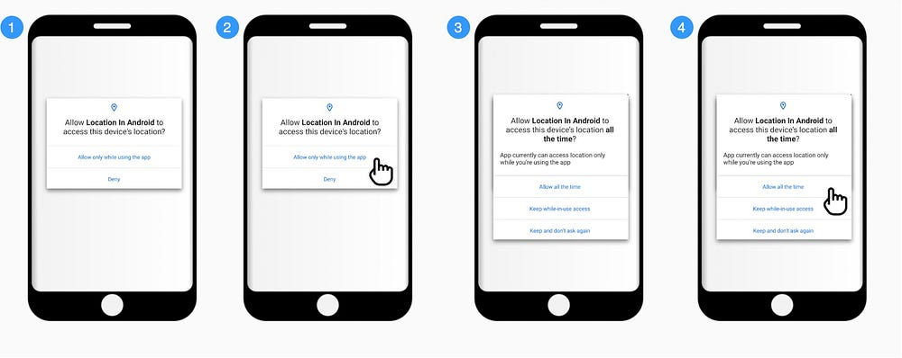
// Request permission
ActivityCompat.requestPermissions(
this@MainActivity,
arrayOf(Manifest.permission.ACCESS_FINE_LOCATION),
REQUEST_FOREGROUND_ONLY_PERMISSIONS_REQUEST_CODE
)
The user will be prompted with a permission dialog (Screen 1), and upon user confirmation, Foreground Location Access is granted to your app (Screen 2).

Slide 8


Working with Google Maps
With the Maps SDK for Android, add maps to your Android app including Wear OS apps using Google Maps data, map displays, and map gesture responses. You can also provide additional information for map locations and support user interaction by adding markers, polygons, and overlays to your map.
The SDK supports both the Kotlin and Java programming languages and provides additional libraries and extensions for advanced features and programming techniques.
NOTE: Due to continues changes in Maps SDK Version we will learn this in lab only.

Slide 9
Introduction to Geocoder
A class for handling geocoding and reverse geocoding. Geocoding is the process of transforming a street address or other description of a location into a (latitude, longitude) coordinate.
Reverse geocoding is the process of transforming a (latitude, longitude) coordinate into a (partial) address. The amount of detail in a reverse geocoded location description may vary, for example one might contain the full street address of the closest building, while another might contain only a city name and postal code.
Use the isPresent() method to determine whether a Geocoder implementation exists on the current device. If no implementation is present, any attempt to geocode will result in an error.
Geocoder implementations are only required to make a best effort to return results in the chosen locale. Note that geocoder implementations may return results in other locales if they have no information available for the chosen locale.

Slide 10
Public methods
List<Address> | getFromLocation(double latitude, double longitude, int maxResults) Returns an array of Addresses that are known to describe the area immediately surrounding the given latitude and longitude.
List<Address> | getFromLocationName(String locationName, int maxResults, double lowerLeftLatitude, double lowerLeftLongitude, double upperRightLatitude, double upperRightLongitude) Returns an array of Addresses that are known to describe the named location, which may be a place name such as "Dalvik, Iceland", an address such as "1600 Amphitheatre Parkway, Mountain View, CA", an airport code such as "SFO", etc..
List<Address> | getFromLocationName(String locationName, int maxResults) Returns an array of Addresses that are known to describe the named location, which may be a place name such as "Dalvik, Iceland", an address such as "1600 Amphitheatre Parkway, Mountain View, CA", an airport code such as "SFO", etc..
static boolean | isPresent() Returns true if the Geocoder methods getFromLocation and getFromLocationName are implemented.

Slide 11
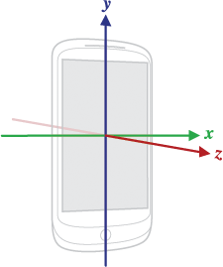
Sensor API
Most Android-powered devices have built-in sensors that measure motion, orientation, and various environmental conditions.
These sensors are capable of providing raw data with high precision and accuracy, and are useful if you want to monitor three-dimensional device movement or positioning, or you want to monitor changes in the ambient environment near a device.
For example, a game might track readings from a device's gravity sensor to infer complex user gestures and motions, such as tilt, shake, rotation, or swing.
Likewise, a weather application might use a device's temperature sensor and humidity sensor to calculate and report the dewpoint, or a travel application might use the geomagnetic field sensor and accelerometer to report a compass bearing.

Slide 12
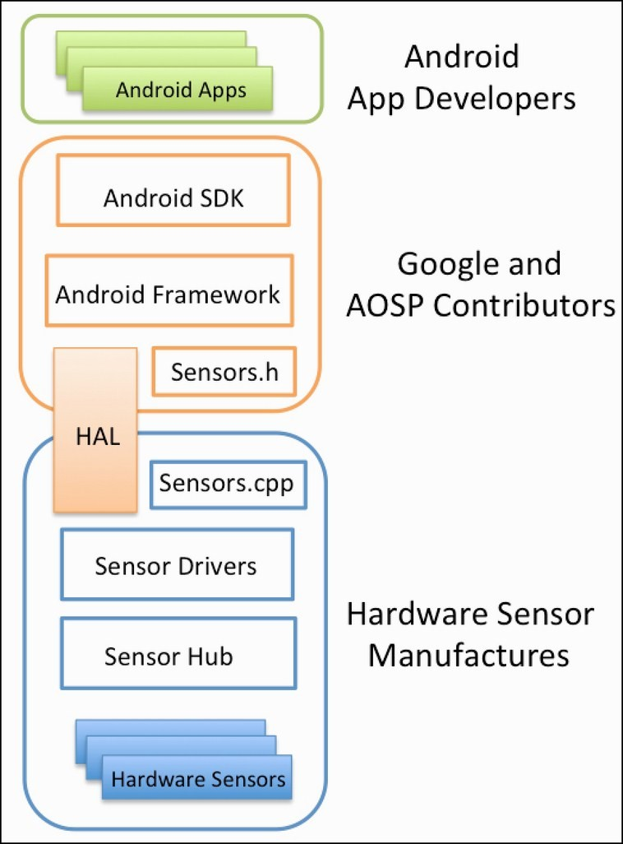
Types of Sensor
Motion sensors
These sensors measure acceleration forces and rotational forces along three axes. This category includes accelerometers, gravity sensors, gyroscopes, and rotational vector sensors.
Environmental sensors
These sensors measure various environmental parameters, such as ambient air temperature and pressure, illumination, and humidity. This category includes barometers, photometers, and thermometers.
Position sensors
These sensors measure the physical position of a device. This category includes orientation sensors and magnetometers.

Slide 13
Sensor Framework
SensorManager : You can use this class to create an instance of the sensor service. This class provides various methods for accessing and listing sensors, registering and unregistering sensor event listeners, and ac-quiring orientation information. This class also provides several sensor constants that are used to re-port sensor accuracy, set data acquisition rates, and calibrate sensors.
Sensor: You can use this class to create an instance of a specific sensor. This class provides various methods that let you determine a sensor's capabilities.
SensorEvent: The system uses this class to create a sensor event object, which provides information about a sensor event. A sensor event object includes the following information: the raw sensor data, the type of sensor that generated the event, the accuracy of the data, and the timestamp for the event.
SensorEventListener : You can use this interface to create two callback methods that receive notifications (sensor events) when sensor values change or when sensor accuracy changes.

Slide 14
Sensor availability by platform.
Sensor | Android 4.0 (API 14) | Android 2.3 (API 9) | Android 2.2 (API 8) | Android 1.5 (API 3)
TYPE_ACCELEROMETER | Yes | Yes | Yes | Yes
TYPE_AMBIENT_TEMPERATURE | Yes | n/a | n/a | n/a
TYPE_GRAVITY | Yes | Yes | n/a | n/a
TYPE_GYROSCOPE | Yes | Yes | n/a¹ | n/a¹
TYPE_LIGHT | Yes | Yes | Yes | Yes
TYPE_LINEAR_ACCELERATION | Yes | Yes | n/a | n/a
TYPE_MAGNETIC_FIELD | Yes | Yes | Yes | Yes
TYPE_ORIENTATION | Yes² | Yes² | Yes² | Yes
TYPE_PRESSURE | Yes | Yes | n/a¹ | n/a¹
TYPE_PROXIMITY | Yes | Yes | Yes | Yes
TYPE_RELATIVE_HUMIDITY | Yes | n/a | n/a | n/a
TYPE_ROTATION_VECTOR | Yes | Yes | n/a | n/a
TYPE_TEMPERATURE | Yes² | Yes | Yes | Yes

Slide 15
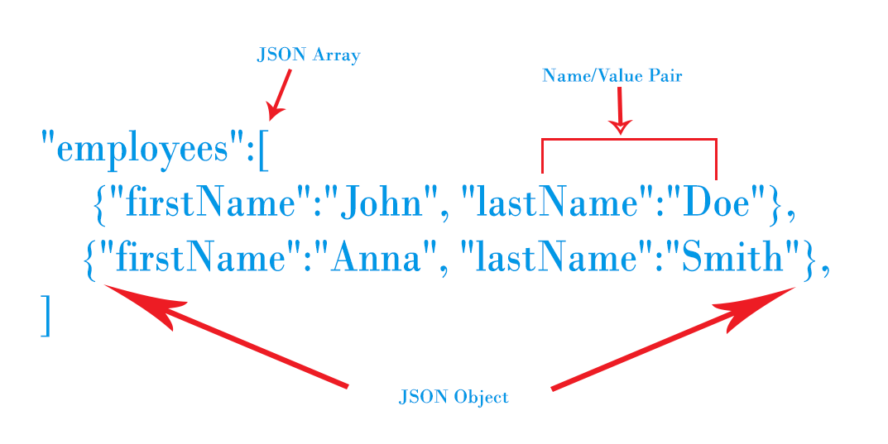
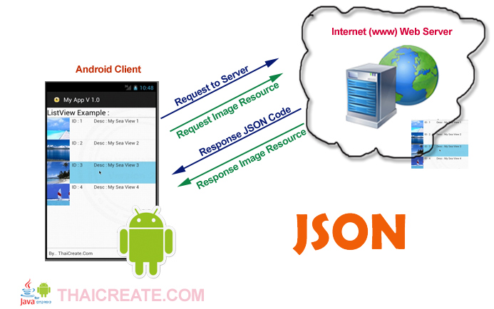
Introduction to JSON Parsing
Problem JSON stands for JavaScript Object Notation and is a simpler format than XML for data interchange.
Many websites provide data in JSON, and many applications need to parse JSON and provide that data in the application.
Using built-in classes such as JSONObject, JSONArray simplifies the process of parsing JSON and retrieving the data values contained in it.

Slide 16
In a real application you would likely obtain the JSON data from some web service. In such method we make use of a JSONObject class object to put in values and then to return the corresponding string (using the toString() method).
Creating an object of type JSONObject can throw a JSONException, so we enclose the code in a try-catch block
We need to instantiate an object of class JSONObject that takes the JSON string as an argument. In this case, the JSON string is being obtained from the getJsonString method. From the JSONObject we extract the information and print it in any container.
Android provides four different classes to manipulate JSON data. These classes are JSONArray, JSONObject, JSONStringer and JSONTokenizer.
 | Component & description
Array([) | In a JSON file , square bracket ([) represents a JSON array
Objects({) | In a JSON file, curly bracket ({) represents a JSON object
Key | A JSON object contains a key that is just a string. Pairs of key/value make up a JSON object
Value | Each key has a value that could be string , integer or double e.t.c

Slide 17
Introduction to Monetization of Android App
Mobile apps were downloaded 230 billion times in 2021 – about 95% free to install. Yet the entire industry generated a whopping $400 billion in that year, according to Statista.
To make sense of these numbers, we have to dig into how apps make money.
App monetization is the process of generating revenue from app users.
This often includes multiple strategies ranging from showing banner ads on the bottom of your app, to leveraging rewarded video ads, and applying integrated advertising methods.

Slide 18
Models for Monetization
In-app purchases (IAP)
The in-app purchase monetization model focuses on selling a variety of virtual goods, services, and bonuses within the app.
In-app purchase revenue can be divided into two:
In-store revenue
Out-of-store revenue
Subscription and freemium models
A subscription model relies on an app being free to download and charges a recurring fee to use over time.

Slide 19
In-app advertising (IAA)
In-app advertising, or IAA for short, is a monetization strategy that leverages an app’s real estate, mainly in gaming, to show ads to their users. In short, advertising space is sold to ad buyers to display ads.
Banner Ads, Video Ads, Rewarded video ads ,Interstitial ads, Native Ads. Playable Ads, Offerwall Ads
Paid Download or Pay Per Download (PPD)
One of the oldest monetization strategies is to charge a one-time fee to download your app.

Slide 20
Signing and Publishing Android App
Android requires that all APKs be digitally signed with a certificate before they are installed on a device or updated.
When releasing using Android App Bundles, you need to sign your app bundle with an upload key before uploading it to the Play Console, and Play App Signing takes care of the rest.
For apps distributing using APKs on the Play Store or on other stores, you must manually sign your APKs for upload.
This page guides you through some important concepts related to app signing and security, how to sign your app for release to Google Play using Android Studio, and how to configure Play App Signing.

Slide 21
Play App Signing
With Play App Signing, Google manages and protects your app's signing key for you and uses it to sign your APKs for distribution.
And, because app bundles defer building and signing APKs to the Google Play Store, you need to configure Play App Signing before you upload your app bundle.
Doing so lets you benefit from the following:
Use the Android App Bundle and support Google Play’s advanced delivery modes.
Increase the security of your signing key, and make it possible to use a separate upload key to sign the app bundle you upload to Google Play.
Key upgrade lets you change your app signing key in case your existing one is compromised or if you need to migrate to a cryptographically stronger key

Slide 22
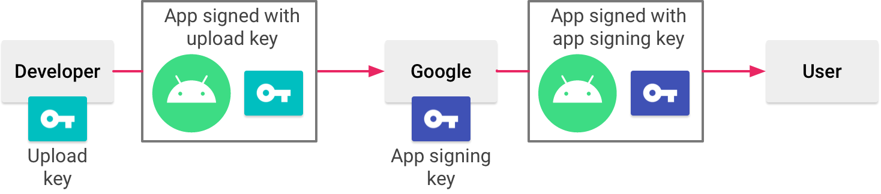
Play App Signing uses two keys: the app signing key and the upload key,
You keep the upload key and use it to sign your app for upload to the Google Play Store.
Google uses the upload certificate to verify your identity, and signs your APK(s) with your app signing key for distribution as shown in figure
1. By using a separate upload key you can request an upload key reset if your key is ever lost or compromised.

